Slide 1
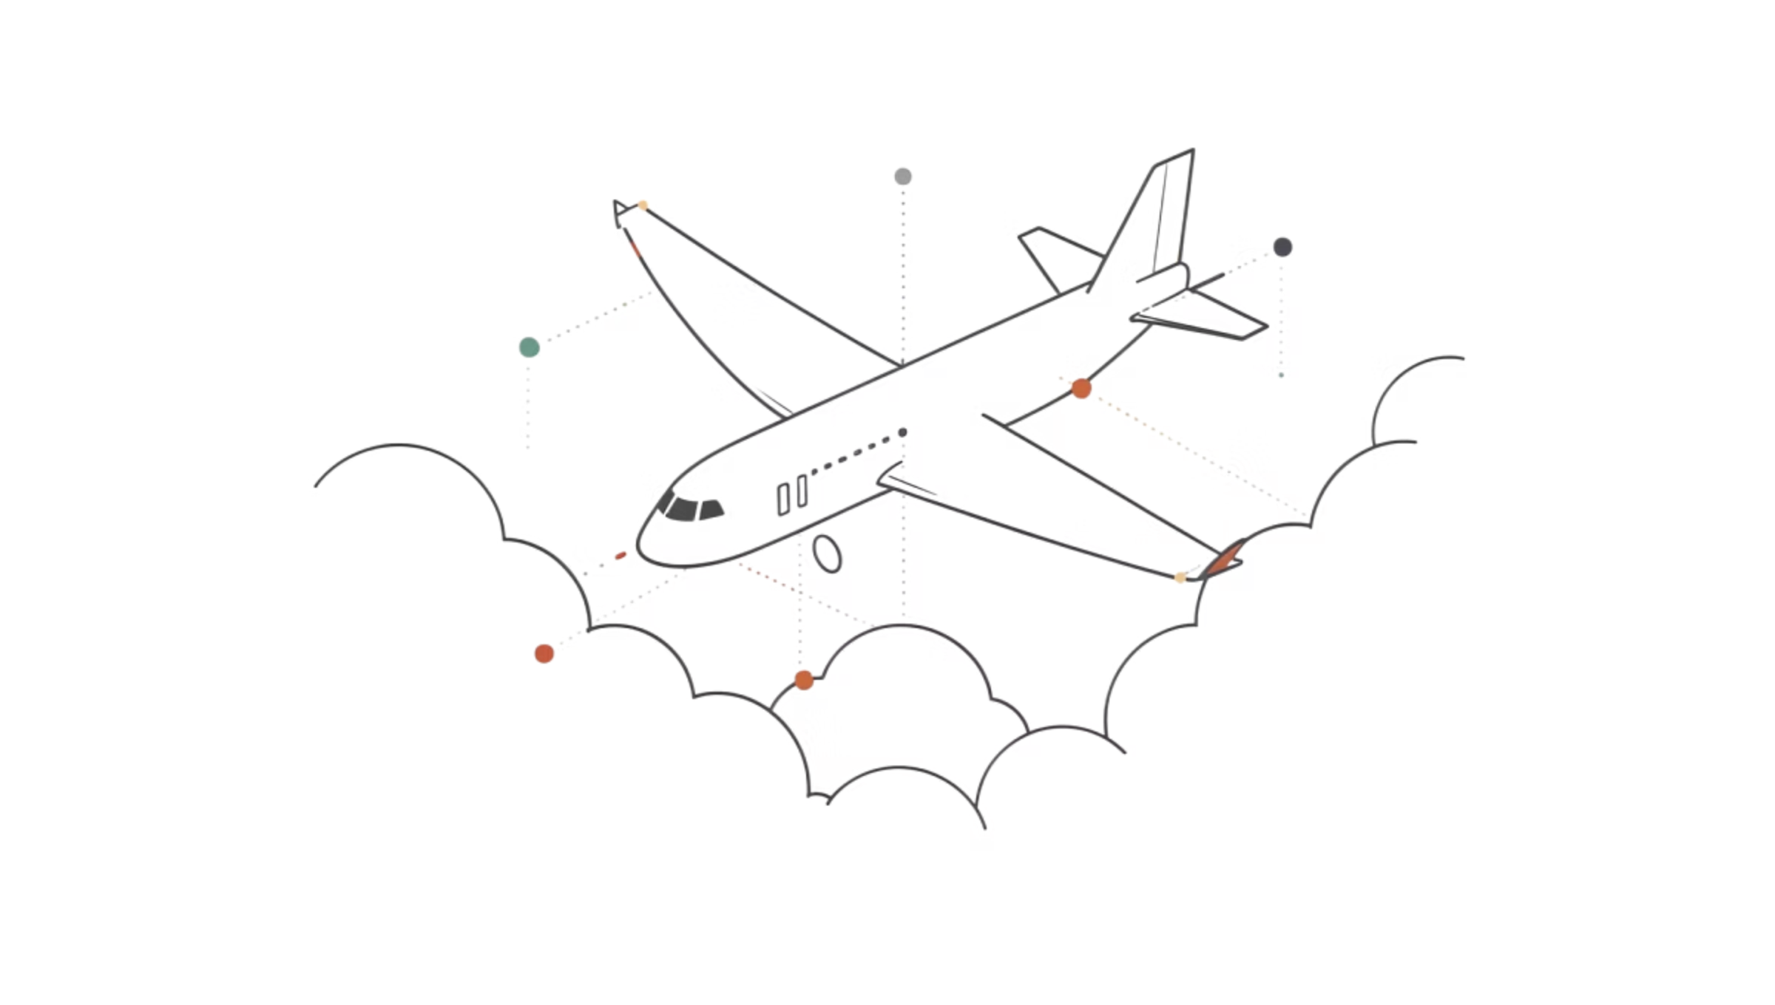
Airline Ticket Booking System
Database Management System Project
Project Team
Jyoti Basu — 2410030205
Sneha Singh — 2410030073
Priyanshi Varshney — 2410030338
Maahi Agarwal — 2410030319

Slide 2
Introduction
What is it?
What does it store?
DBMS Concepts Covered
A relational database designed to manage flight bookings end-to-end.
User details, flight information, airline data, ticket bookings, and payment records.
Tables, relationships, primary keys, foreign keys, and normalisation.

Slide 3
ER Diagram
The ER diagram below represents the entities and their relationships in the system.
Entities
Relationships
User
Flight
Airline
Ticket
Class
Payment
User ↔ Ticket
Ticket ↔ Flight
Flight ↔ Airline
Ticket ↔ Class
Ticket ↔ Payment

Slide 4
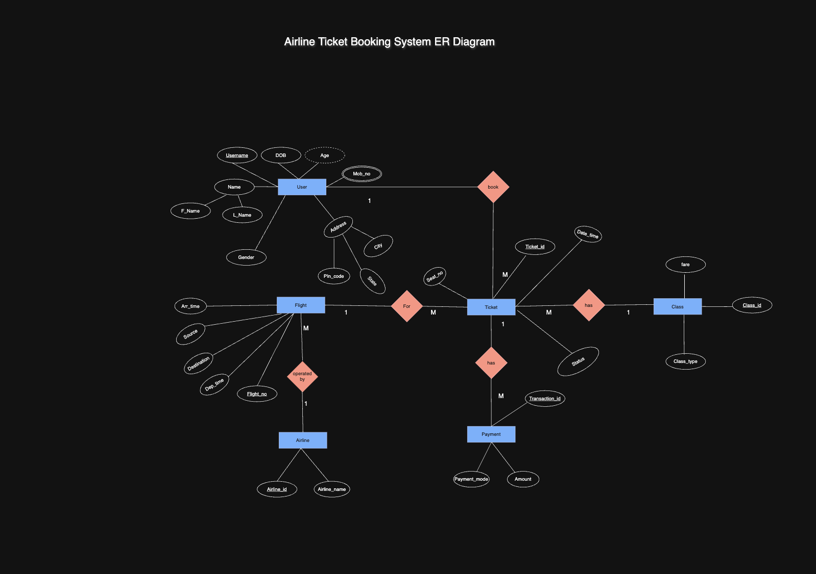
ER Diagram

Slide 5
Entities Overview
Entity
Attributes
USER
user_id, name, dob, city
FLIGHT
flight_no, source, destination, dep_time, arr_time
AIRLINE
airline_id, airline_name
TICKET
pnr_no, user_id, flight_no, class_id, seat_no, status
CLASS
class_id, class_type, fare
PAYMENT
transaction_id, pnr_no, amount, payment_mode

Slide 6
Relationships & Cardinality
User → Ticket
Ticket → Class
1 : M
M : 1
Ticket → Flight
Ticket → Payment
M : 1
1 : 1
Flight → Airline
M : 1

Slide 7

Schema / SQL Design
Sample CREATE TABLE statements for key tables:
CREATE TABLE USERS (
user_id INT PRIMARY KEY,
name VARCHAR(100),
dob DATE,
city VARCHAR(50)
);
CREATE TABLE FLIGHT (
flight_no INT PRIMARY KEY,
source VARCHAR(50),
destination VARCHAR(50),
dep_time TIME,
arr_time TIME,
airline_id INT,
FOREIGN KEY (airline_id) REFERENCES AIRLINE(airline_id)
);
CREATE TABLE TICKET (
pnr_no INT PRIMARY KEY,
user_id INT,
flight_no INT,
class_id INT,
seat_no VARCHAR(10),
status VARCHAR(20),
FOREIGN KEY (user_id) REFERENCES USERS(user_id),
FOREIGN KEY (flight_no) REFERENCES FLIGHT(flight_no)
);
Tables are connected using primary keys and foreign keys to maintain relationships.

Slide 8
SQL Queries
1
2
SELECT
JOIN
Retrieve flight details based on source and destination.
Combine User, Ticket, and Flight tables to get booking details.
3
4
AGGREGATE
SUBQUERY
COUNT and SUM used for total bookings and revenue.
Used to find specific filtered data from nested queries.

Slide 9


Normalisation
The database is normalised up to Third Normal Form (3NF).
3NF
2NF
Airline, Class, and Payment stored separately to remove transitive redundancy.
1NF
User, Flight, and Ticket separated to remove partial dependency.
Phone numbers stored in a separate USER_PHONE table — no repeating groups.
Foreign keys are used throughout to maintain referential integrity across all tables.

Slide 10
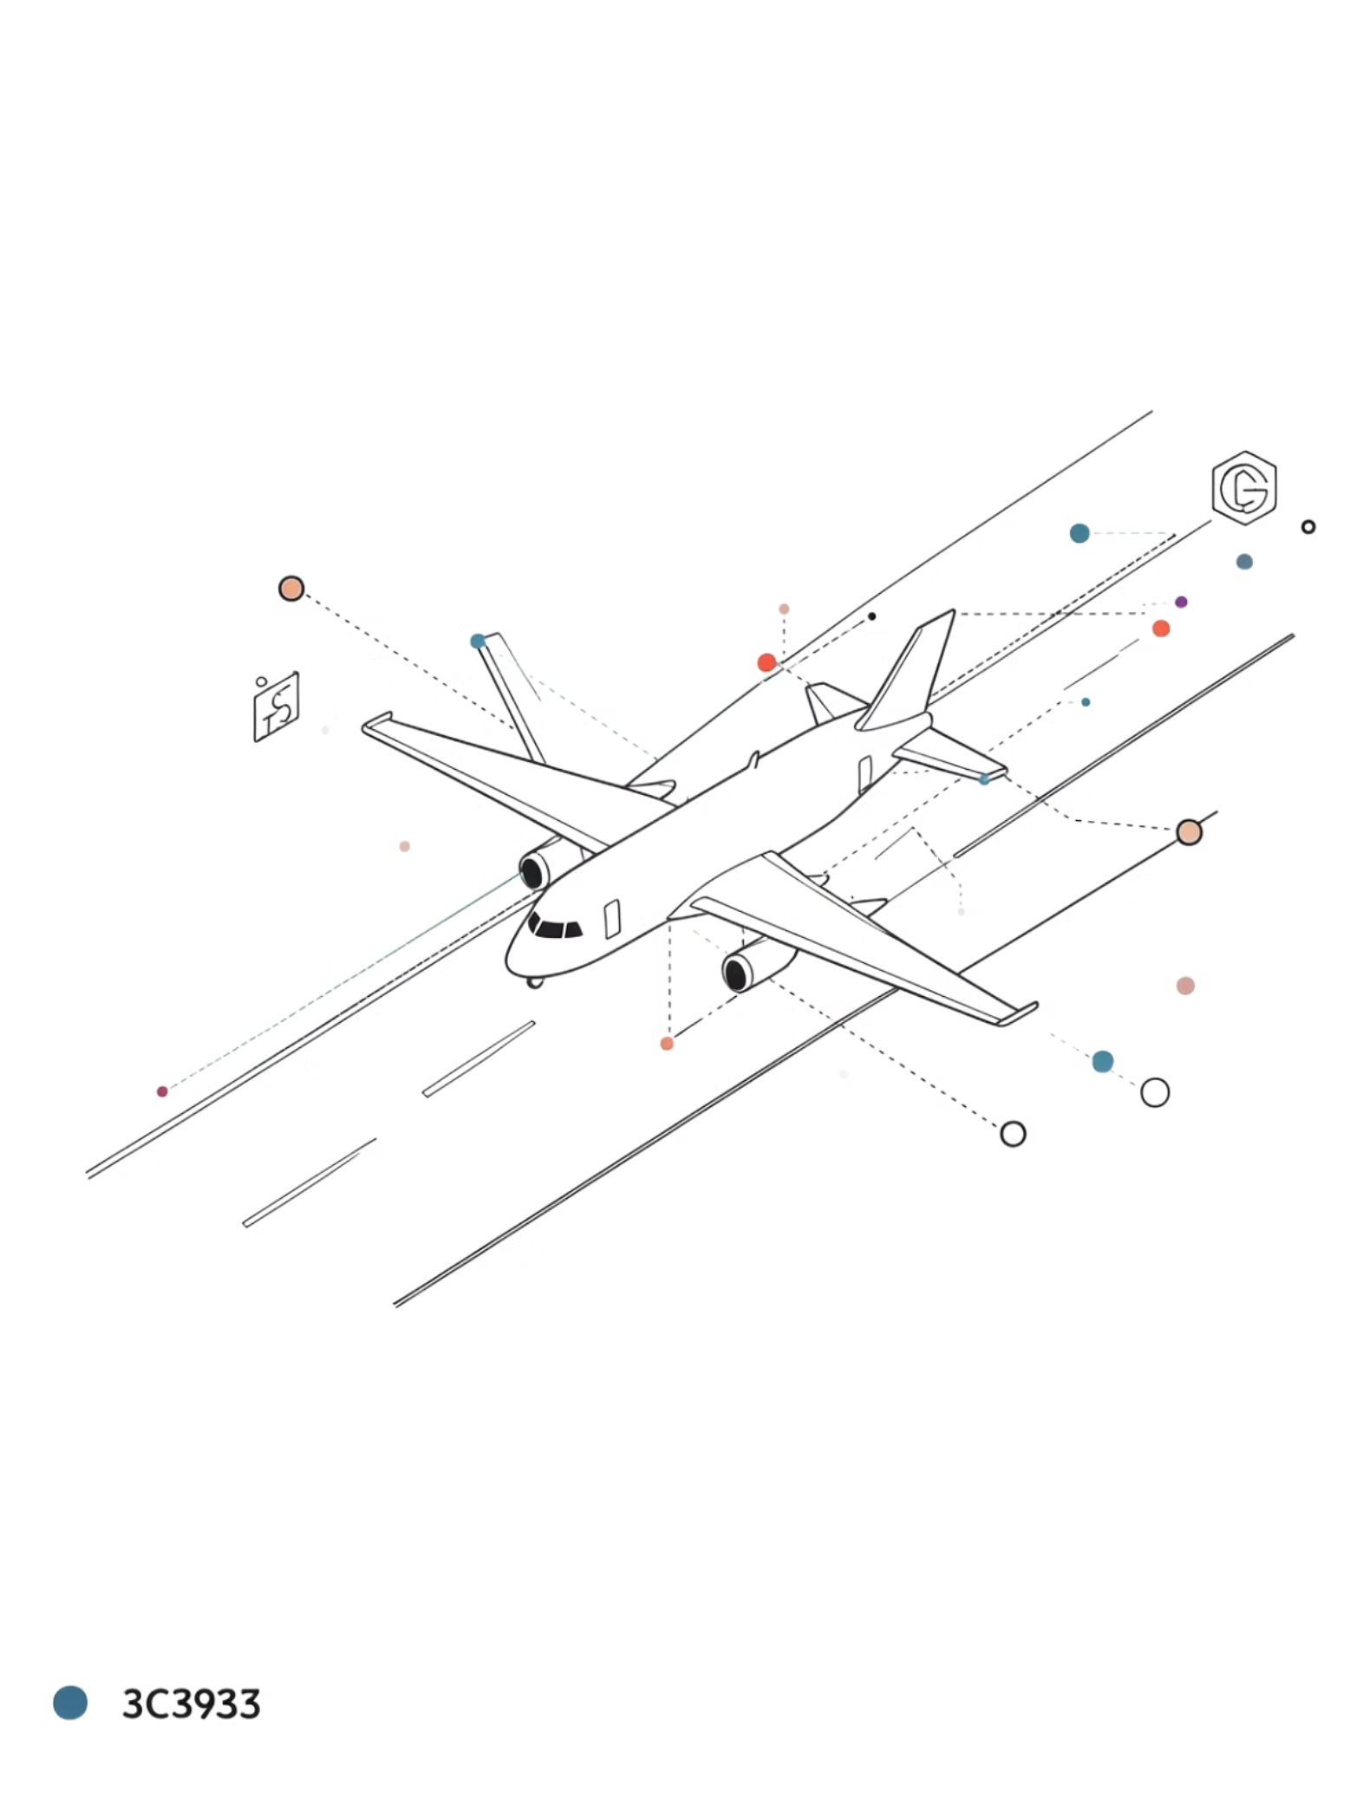
Conclusion
Well-Structured & Normalised
The system follows a clean relational design normalised up to 3NF.
Minimal Redundancy
Data integrity is maintained through proper use of keys and separate tables.
Real-World Application
Demonstrates practical DBMS implementation for an airline booking scenario.

